Slide 1





Year 11 Mock Exam Results Reveal & The Year Ahead

Slide 2


Opening Prayer and Welcome
Loving Father,
Be with us in our learning, our friendships, and our challenges,
and remind us that we are never alone.
With Your love, help us to aspire to excellence,
always trying our best and minding our manners.
May we follow the example of St Joseph,
and grow in inner strength each day.
Guide us as we walk in the footsteps of Jesus Christ,
and help us always to know that You are with us.
Amen.

Slide 3

Thank you & Teamwork
(RRO)
Thank you
Some sobering thoughts;
Only get one chance at Year 11
9 months
28 weeks
Don't count the days, but make the days count
Teamwork & Wanting the best:
Year 6 evening
3 parts to this team
More important than ever!

Slide 4

The Results
(RRO)
There'll be a mix of emotions today:
  Relief
  Joy
  Anger
  Frustration
  Sadness
What these results aren't:
The final results
All you can achieve
A reason to be complacent
A reason to give up – every grade matters!
What these results are:
YOUR mocks
An indicator
A motivator
A starting point

Slide 5

Reflections
(OFO)
In your envelope, along side you results, is a copy of the reflection sheet you completed immediately after your final mock exam.
These serve as a starting point for the question – what can I do to improve in November?
Homework:
When you go home, on Class Charts will be a link to an online reflection form
There are 21 questions to aid your reflections;
  19 for pupils
  3 for parents
It'll take approx 10 minutes to complete.
The 3 relating to college courses will aid our future planning for WIN sessions and your careers meetings

Slide 6

How We Will Support Your Child
(OFO)
Study Skills
  Sessions (PSHE / Tutor Times / Assemblies)
  How to revise subject specific guidance
  General Study Skills Booklet
WIN Sessions – What I Need sessions
Mentoring for select pupils & tailored timetables
February Half Term & Easter Revision Sessions
Mock Exams (aka chances to practise!)
  November – core subjects
  January – all subjects
Regular Home learning
  Supports with information recall
  Supports with exam practise
  Homework club available every night (15:40-16:10 in RM28)
Pastoral help
  Form Tutors, pastoral managers
College awareness & Careers interviews
  Open days regularly communicated
  Interviews - all will have had an interview by the end of this term

Slide 7
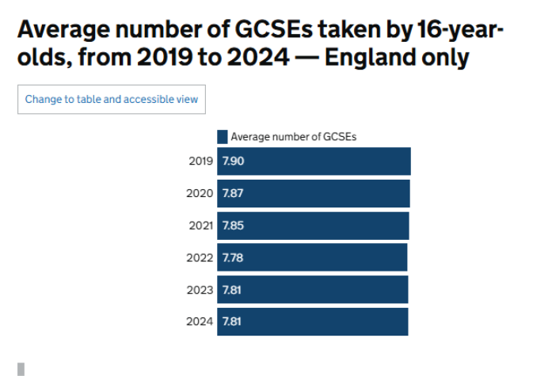
No Curriculum Rationalisation
(OFO)
Previously students were taking too many qualifications and were over-stretched.
This year group does not have that problem:
  3 options subjects rather than 4
  5 hrs per fortnight for each subject rather than 3 hrs.
You are in a strong position to finish school with 8 or more good GCSE grades which will put them slightly above the national average.
Colleges – more frequently asking for a score than particular GCSE grades
In short (more later) – “dropping” is going to be a thing of the past this ear.

Slide 8

WIN – What I Need Sessions
(RRO)
Sept – Dec
  Core subjects during morning form time
  Options subjects offering drop-ins at lunch time / after school
  Thrive & Fly Programme for G&T
Jan – Exams
  Compulsory sessions for identified pupils
  30-minute weekly sessions
  Chocolate to boost energy at the start!
  Low-Stakes Retrieval – quiz/mini whiteboards/brain dumps
  Exam Technique
  Modelling of exam answers using visualisers or chalk & talk
  Independent practise for the pupils
  Morning Formtime sessions continue

Slide 9
Why this Approach?
(RRO)
Mindset Shift – it's in your hands!
In WIN sessions we combine high expectations with meaningful support and help students understand that success is built on strategies they can control
We give them the confidence to keep trying, to see failure as part of learning, and to believe that success is within reach.
Cognitive Shift – being active not passive learners!
Study of students actively and passively revising
Active = Not sit and listen, but actively recall and produce answers

Slide 10
WIN Sessions – beginning January (Example)
(RRO)
Day | Monday | Tuesday | Wednesday | Thursday | Friday
Lunch | History GCSE PE | Geography | English Language |  | GCSE PE Art
After - School | RE Spanish French | English Literature Sociology Computer Science/ Creative Media Combined Science | Maths Combined Science Food Tech Music | Maths Triple Science Drama Combined Science Spanish

Slide 11
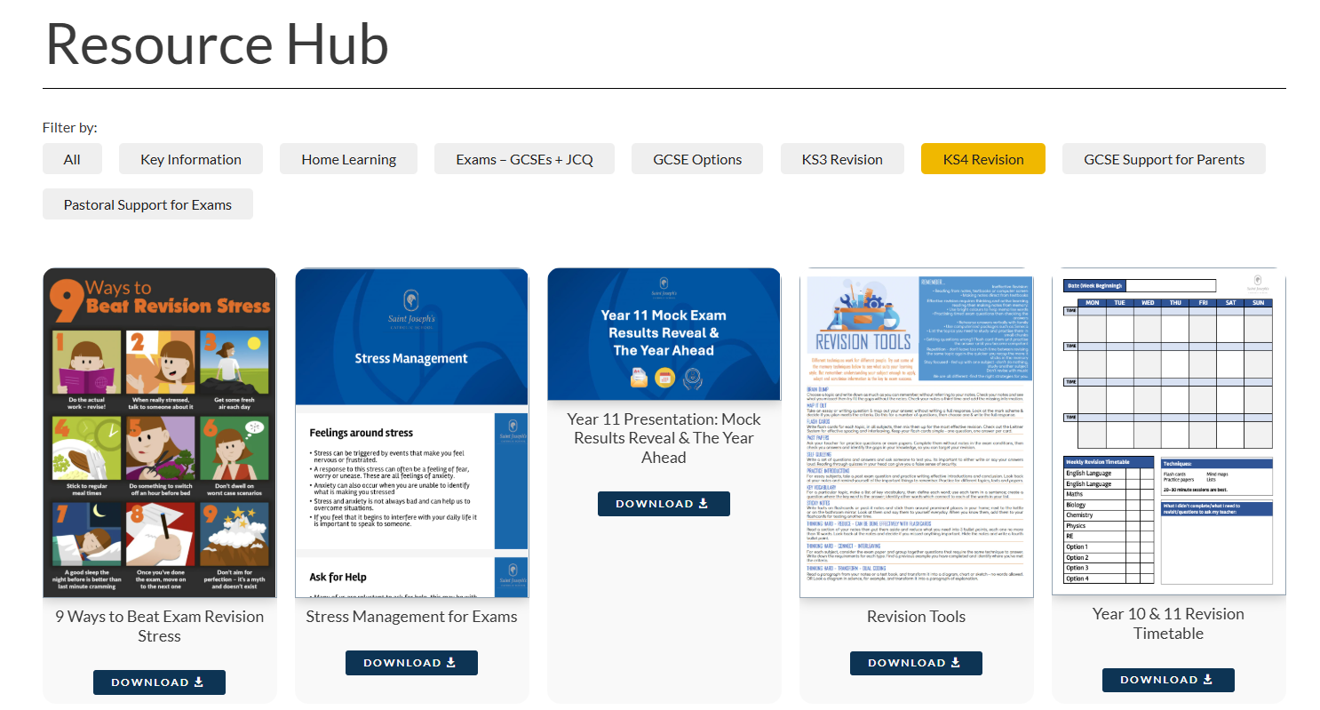
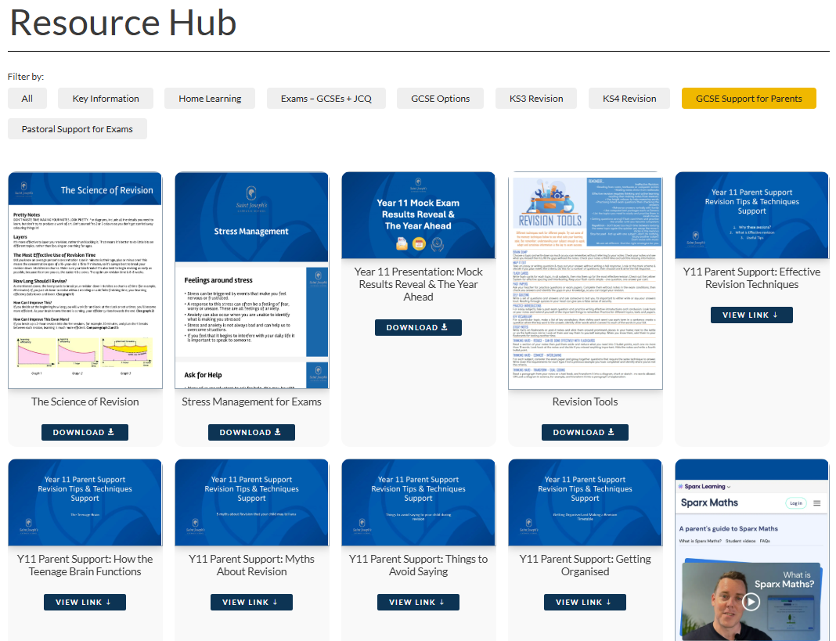
How We Will Support You – https://www.sjcs.org.uk/resources/
Study Skills
  Online clips
    Effective Revision Techniques
    Myths about revision
    How the teenage brain functions and what this might mean for revision
    Things to avoid saying to your child during revision
    Getting organised – revision timetables and flashcards
    Your suggestions!
  Booklets
    Beating Exam Stress
    Study / Revision Skills tips
    Revision Timetable
Being a call or an email away

Slide 12


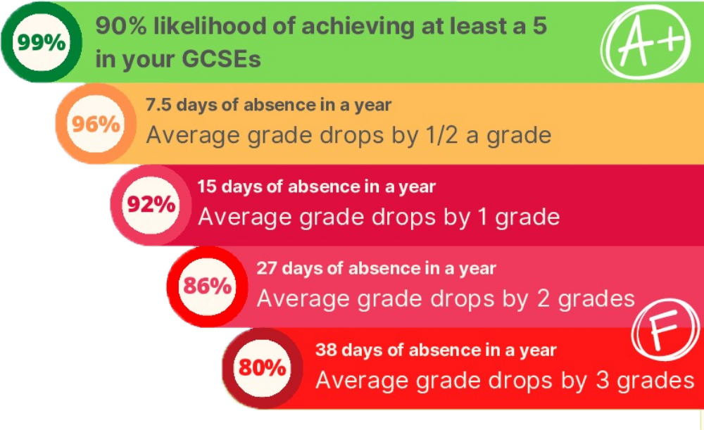


Parents - How You Can Help
(OFO)
Attendance
Homework
Attendance at parents' evening
Take an interest
  Look through work / books with them (Progress trackers)
  Be willing to be a revision partner / help facilitate and prompt good revision
Get in touch if you have concerns
Provide balance

Slide 13


Students – Remember, it’s all about you
(OFO)
This is about your future
> It will be your results day in 11 months
> They aren’t your teacher’s grades – it’s support not pressure
> We want you to have your choice of doors to walk through…

Slide 14
Important Dates
(RRO)
Form Tutor Evening (online): Week Commencing 12th October
Mock Week and In Class Assessments: Week Commencing 2nd November
1st Progress Reports – Week Commencing 30th November
Parents Evening: Thurs 10th December
January Mock Exam Series – Week Commencing Mon 11th January
Results report comparing Target, Sept & Jan grades and predicted grades – end of term 3 (week commencing 8th Feb)
2nd Progress Reports – end of term 4 (week commencing 22nd March)
Open Events at colleges & deadlines check the website
Official GCSE Exams begin: Monday 10th May
Contingency Date for exams - Wednesday 23 June 2027 all day

Slide 15

The Year 11 Journey & Events
(JSN)

Slide 16



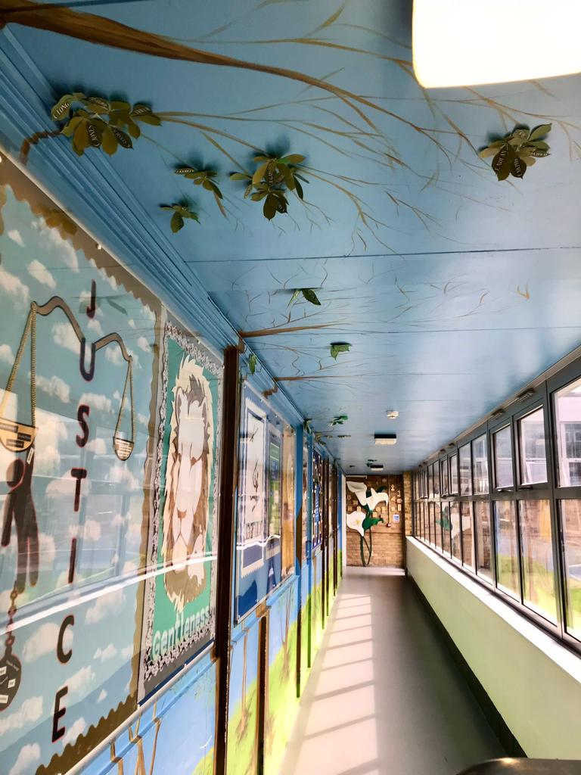



The Year 11 Journey & Events
(JSN)
Lots of good things to come...
  Prom
  Dance-Off
  End of Year Yr11 vs Staff Football & Netball
  Big Sleep
  Leavers breakfast
  Y11 trip…

Slide 17




The Year 11 bonding trip...
(JSN)
A Year Group visit to Ninja Warrior in Southampton!
Friday October 16th.
2hrs Ninja Warrior
Buffet lunch included

Slide 18


Miss Gale, Head of Careers & PSHE
Year 11 Careers Support
1:1 Meetings
PSHE lessons
Post-16 Assemblies/ talks
Apprenticeship talks/ information
Online resources (Morrisby *NEW for 2026/27) and parent information via Class Charts
Drop in’s Tuesdays and Thursdays
Careers@sjcs.org.uk
Notes:
*1:1 meetings – Inline with Gatsby students receive impartial careers guidance from myself, a Level 6 qualified Careers Advisor to support their decision making for Post-16. (Any parents wish to meet also or have a phone call please let me know- this is a partnership and for some parents they've done it before, for some it's first time, here to help! E-mail me
*PSHE lesson – with HoY and set teachers will guide them through Post-16 options and how to make an informed decision that's right for each individual child.
*In line with the Baker clause, we welcome representatives from all local post-16 providers into school to speak to our students at assembly time on set Fridays Sept to November.
We will encourage all students in Year 11 to apply to at least two separate establishments, but some may choose to apply to more. The decision as to which placement to accept (following offers of a place) do not normally need to be made until exam results have been received in August.
Students are encouraged to attend open evenings around the time of applications and be aware that each establishment has different deadlines for applications. Handout regarding local Open Days available to collect at the end of this talk in reception area and will be e-mailed home/ via class charts.

Slide 19
Choosing options – some key points
What grades are you likely to get at GCSE?
Check the college, 6th Form, apprenticeship entry criteria – Remember these are "minimum" - places are competitive – they look for "what else" & broad range of GCSE's
*Some 6th forms require a grade 5-7 to study a specific subject at A-level; Some Universities/ subjects require a min grade 5-7 GCSE English and Maths.
Go to Open Days to find out more about the subject/ course content – what exactly will you study?
Handout available!
There are lots of ways of getting to the same future job.
But you need to work hard to make "options" available.
Notes:
Your journey – make the choices that are right for you!

Slide 20
Steps to Success
Post 16 Careers Evening
Date for your diary:
Thursday 1st October 5.00pm
Information about the options available, the different levels and the process for Post-16 applications.

Slide 21

Stay Strong & Stay Together
This isn't going to be easy or plain sailing
We stay strong
We stay together
We play our part
We all 'do our best and mind our manners' no matter how things might feel like they're going!
Don't count the days, make the days count!

