Slide 1


Prayer and Values Tree (MHI)
Welcome to St Joseph's
We are on an exciting journey together.

Slide 2
Prayer and Values Tree (MHI)
Loving Father,
Be with us in our learning, our friendships, and our challenges,
and remind us that we are never alone.
With Your love, help us to aspire to excellence,
always trying our best and minding our manners.
May we follow the example of St Joseph,
and grow our inner strength each day.
Guide us as we walk in the footsteps of Jesus Christ,
and help us always to know that You are with us.
Amen

Slide 3

What we all want (MHI)
Well-rounded pupils:
Fulfilling academic potential
Developing into polite, well-mannered young adults
The motto to remind your children of:
"Do your best and mind your manners!”

Slide 4
Welcome – we are School on a Mission! (MHI)
It is normal to worry when children go from Primary to Secondary.
Kindness, care and compassion - the School and your Headmaster.
We work with Parents, Pupils and Us together.
Pupils are known, understood and supported.
Our Catholic Values are child centred so that they can flourish.
We will support and ensure your child makes the best progress for them.
We will support and ensure your child makes the best progress for them.
We teach to the top, curriculum planning enables pace, challenge and retrieval.
Results improving year on year (15% up on average) - 76% English and 72% Maths (9-4)
On track this summer to be the highest performing local Comprehensive School.

Slide 5
Welcome – we are School on a Mission! (MHI)
Lots of extra opportunities will be provided.
Enrichment and sports (team working) has been increased in the curriculum
Every pupil will start with the end in mind through a highly effective careers and PSHE programme.
We have a true sense of family.

Slide 6

Head of Year (HSH)
Starting secondary school is a big milestone – not just for the children, but for families, too.
Our goal is simple: to help every student feel safe, valued, and inspired.
We place a strong emphasis on kindness, respect, and responsibility. These values are at the heart of everything we do.
As parents and carers, your role is vital. The partnership between home and school is one of the most powerful tools we have to help your child succeed.
We are here to support your child every step of the way.
Year 7 will develop a sense of identity within the school this year which will form the foundation for their time at St Joseph’s.
Year 6, it is time for you to spend some time with your new Form Tutors!

Slide 7

Transfer Experience (RRO)
Summer work – Send us a Postcard & Reading challenge
Transition Webpage
1st Day:
  Year 7 and 11 only day
  Welcome assembly & Extended form time
  Tour of school & map
  ICT sessions to ensure all can login to our systems
Early lunches
House party
Year 7 bonding event
Year 7 Form Tutor Evening

Slide 8
How can I help?(RRO)
Be on top of their Attendance.​
Monitor Class Charts​
Provide a space to work at home.​
Encourage your child to read/read with your child.​
Talk to your child about their learning.​
Help your child to be prepared for learning.​
Let us know if there is a problem.

Slide 9
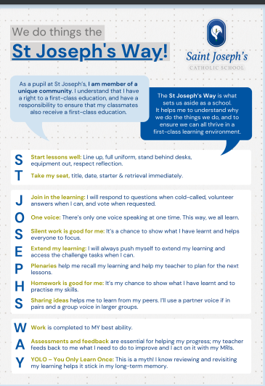
Teaching and Learning(RRO)
Our approach to Teaching and Learning
Ensure settled and purposeful learning environments
Ensure your child has the best possible learning experiences
Learn from subject specialists in every area
Teaching informed by the latest research
Variety of methods to ensure your child is an active learner

Slide 10
Our Curriculum (RRO)
Key Stage 3 (Yr-9) - Breadth
Varied curriculum with 16 different subjects being studied
Core: Maths (7), English (8), Science (6), RE (5)
Humanities & Arts: Spanish / French (3), Geography (2), History (2)
Creative: Music (2), Art (2), Computer Science (2), Drama (1)
Creative Carousel: Food Tech, Business Studies, Design, Textiles – 9-week block of all 4 subjects (smaller group sizes)
Physical Education & Enrichment (5) - Yr7 Mon P5 is Enrichment
Key Stage 4 (Yr10-11) - Depth
Varied and balanced curriculum
3 options choices – creative and academic subjects represented
All students take 9 GCSEs

Slide 11







Homework (RRO)
How do we approach homework?
How will be set?
In the way we wish our own teachers had when we were at school!
Homework forms a valuable part of our curriculum / assessment process – independent learning!
Only set when it adds value –reinforce, consolidate or pre-learning
But we also appreciate the need for students to unwind / relax, pursue outside of school clubs / hobbies and spend time with family
Designed to be easy and simple for students and parents:
Single-sign in
Work on all devices
Set Wed-Tue
Instant feedback

Slide 12
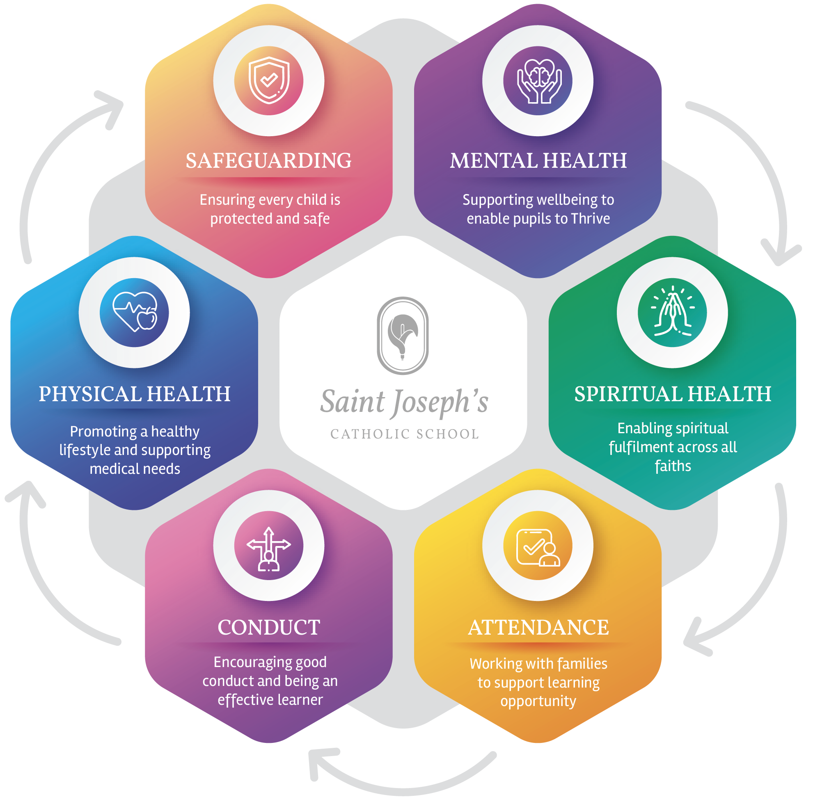
Pastoral Care and Inclusion (KMC)
Our Inclusion Team has your child at the centre of everything we do. You will meet some of these key figures tonight, but we are all available whenever you need us.
The foremost person to support either your child, or you as a parents is the Form Tutor.
If more focused help or support is needed, then we have a dedicated team of staff to support your child's transition to St Joseph's.
Mr. Bennett – Mental Health Lead
Mr. Blaho – School Chaplain
Mrs. Sheppard – Attendance Officer (more later!)
Mrs. Pearson – Medical Officer
Mrs. Rose – DSL - Operational

Slide 13

Attendance (KMC)
Attendance Matters to us.
We understand there are times when attending school is impossible.
The impact of missed attendance is so significant we work closely with families to overcome any barriers that may exist.

Slide 14
SEND Department (EMA)
Mrs Emma Maher, SENCO – senco@sjcs.org.uk
Mrs Wendy Jones, Assistant SENCO & Dyslexia Specialist
Who are we? - SENCO, Assistant Senco, 2 ELSA, 7 TA's
TA Support – whole class department approach / interventions
Haven – Quieter area for social times
ELSA – Full-time provision
Learning Support Plans for all pupils on the SEND Register (Assess-Plan-Do-Review)
Social Skills / Literacy / Numeracy / S&L / Board Games / Art

Slide 15






Reports and Communication (OFO)
Information Evening
Tutor Evening
Parents' Evening
Mid-year and End-of-year reports including:
  Attitude to learning
  Academic progress
  Progress towards Age Related Expectations (AREs)
  Pastoral data (attendance, achievement etc.)
Regular Updates:

Slide 16
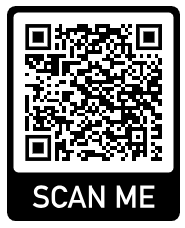













Digital Literacy and eSafety (OFO)
Over the course of their time at St Joseph’s we place a strong emphasis on equipping students to succeed and keep themselves safe in the digital world that they inhabit now and that they will go on to inhabit when they leave us. Aiming to create a generation of responsible digital citizens.
What should you be doing at home?
Our advice?
Foster open discussion and sharing around devices
Be aware of group chat dynamics
Be aware of SnapChat
Check out #wakeupWednesday

Slide 17
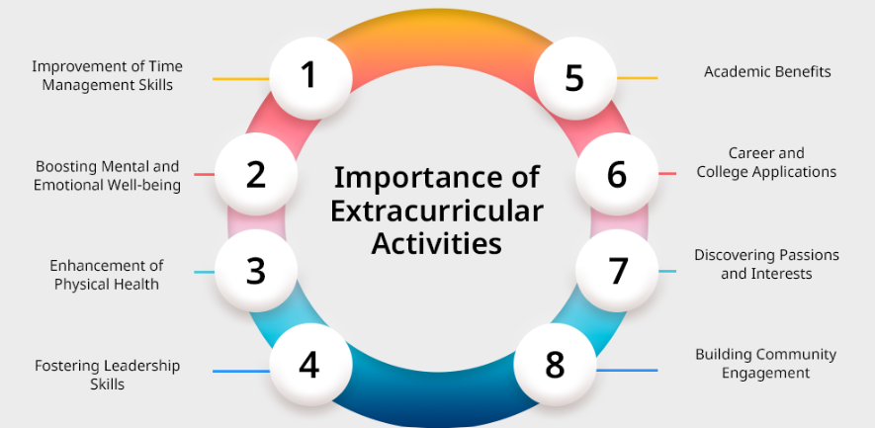
Co-Curricular (MHI)
Opportunities on offer:
Sports
Music
Revision Sessions
STEM
Dance
Drama & Theatre
Foreign Trips
Humanities
Young Enterprise

Slide 18
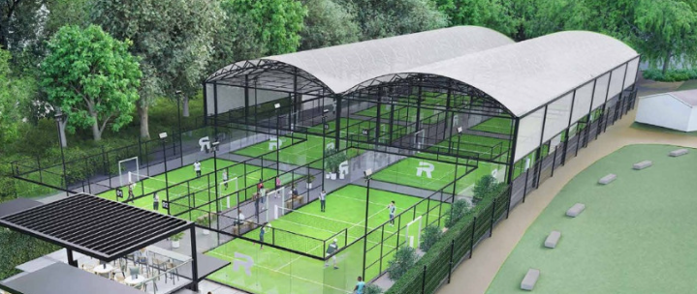
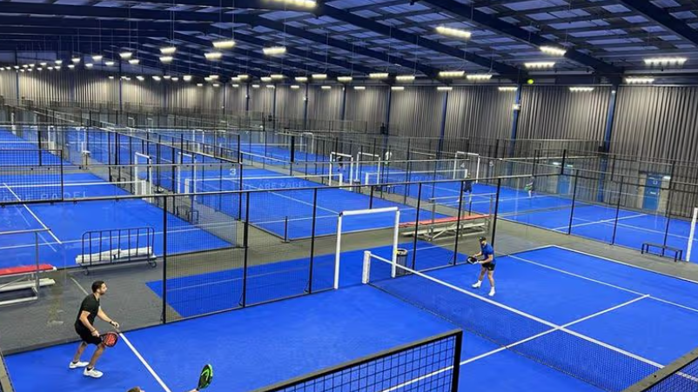
Enhancement of our Sports Facilities (MHI)
Padel Centre

Slide 19
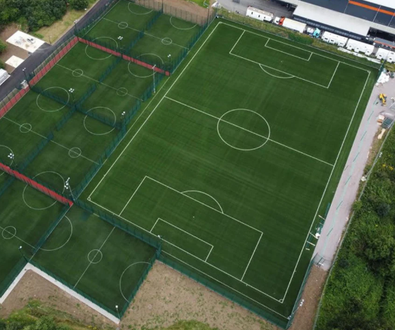
Enhancement of our Sports Facilities (RRO)
4-G Pitches
Via Sports England Bid

Slide 20
Importance of Teamwork (MHI)
THREE vital parts to this team
All wanting the same outcomes
All need to support each other
We all want the best for your child!

Slide 21

Welcome to St Joseph’s! (MHI)
Our journey has started
It may not be smooth all the time, but working together will ensure we set out to achieve our aims
And remember to remind your child to
“Do your best & mind your manners”

Slide 22

Any Questions (MHI)
Your child came home today with a welcome letter, details of the summer challenges and a school calendar.
Don’t forget the transition webpage has a FAQ section
If you feel more comfortable emailing, please email transition@sjcs.org.uk and we’ll get back to you.

