Slide 1


Exam Information Evening

Slide 2
Dear Lord, As we gather this evening—parents, staff, and our Year 11 pupils—we thank You for the opportunity to come together in support of these young people as they prepare for the important months ahead. We ask for Your guidance and wisdom as we share information, make plans, and discuss the journey toward their exams. Grant our pupils confidence in their abilities, clarity of mind as they revise, and the resilience to keep moving forward even when the pressure feels great. Support their families with patience, strength, and encouragement, and bless our staff as they continue to guide and inspire. May this evening bring reassurance, focus, and unity as we work together toward success. Amen.

Slide 3


Welcome
We will cover the following:
Expectations
How to prepare the night before
How to prepare on the morning
How to deal with stress and support we can offer
Exam Timetables

Slide 4
Your Pack consists of: Exam Timetable x 2 School Exam Information Booklet JCQ Instructions for Candidates
School Information Booklet:
Rules & Regulations
Timings
AM exams – Reg at 8:45, Exams begin at 9:00
PM exams – Reg at 12:45, Exams at 1pm
Inform us of illness before 8am by calling school switchboard (medical evidence)
FAQ section - 'what if...'
JCQ Instructions:
Rules & Regulations

Slide 5

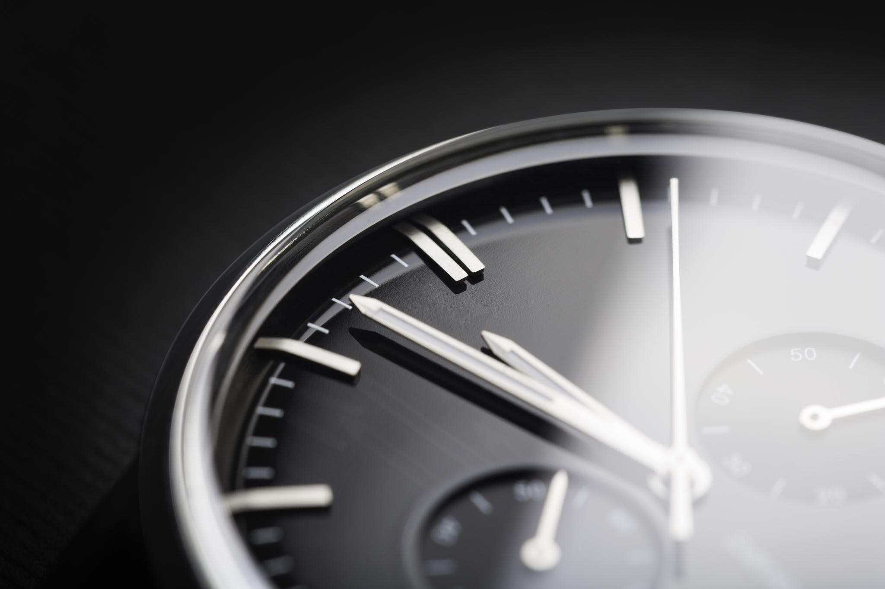
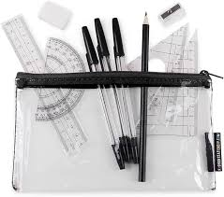
Expectations - Pupil
You arrive in full uniform
You arrive on time – 15 mins before the start of the exam
Do not bring in a watch.
You have all of your equipment including :
Black ball point pen and 2 spares
Ruler
Calculator

Slide 6
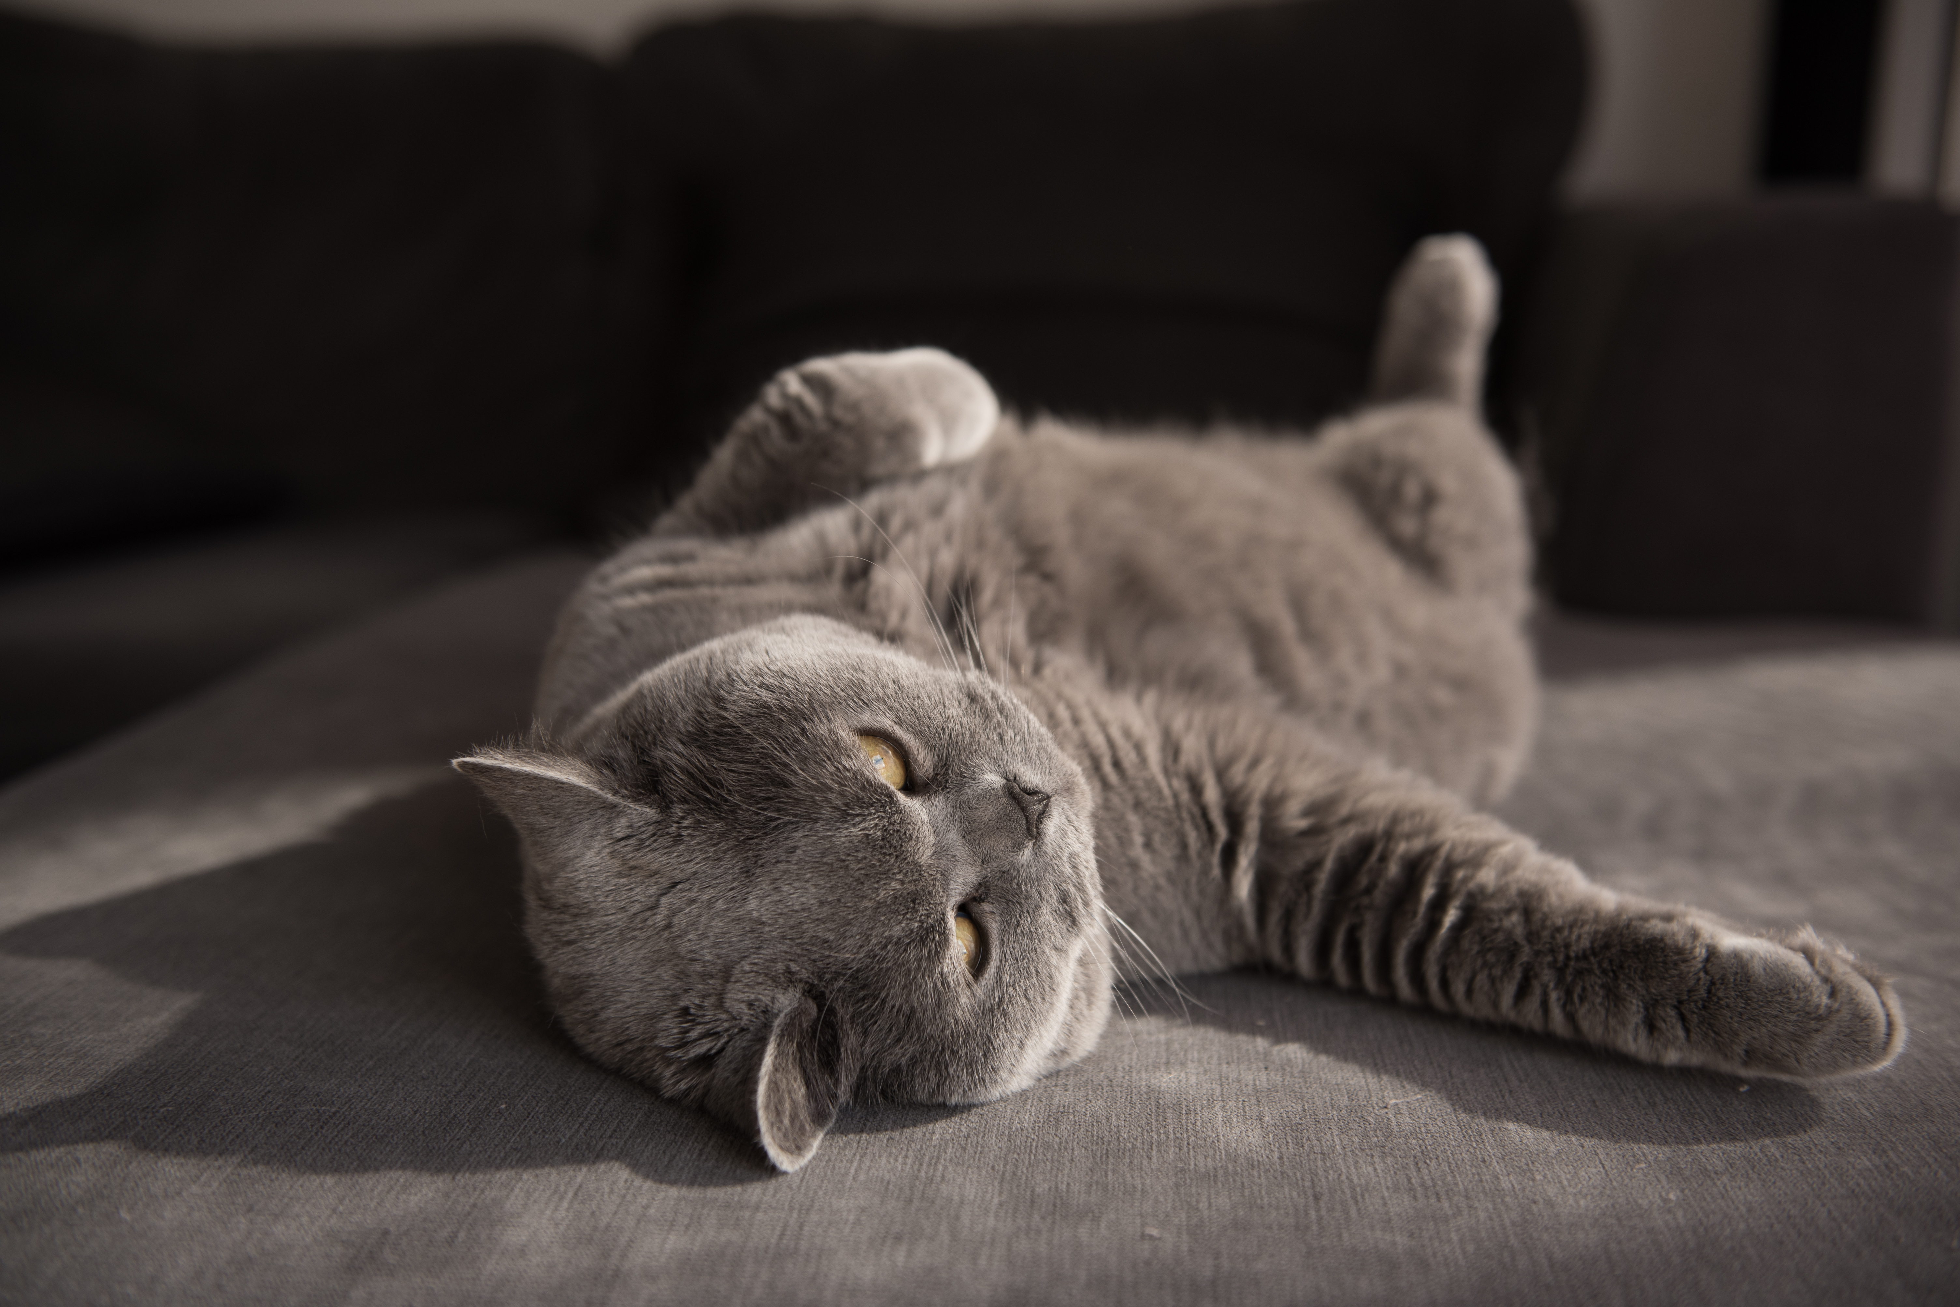
How to prepare the night before...
Stop revising at a reasonable time.
Have a good meal.
Switch off screens an hour before sleep.
Prepare uniform.
Pack equipment.
Headspace App. - Pupils can use the school email address to login.

Slide 7

In the morning...
Get up in plenty of time. No rushing.
Have breakfast.
Double check bag and equipment.
Bottle of Water – No label
Leave to get to school in plenty of time.
Wear full school uniform.
Do not bring in valuables – Air pods, Apple watches,etc.

Slide 8

Arrival at school...
Canteen will be open from 8.30 to buy food
Pupils will be able to congregate in the canteen.
Staff will be there to discuss last minute worries and questions.
Bags will be left in new lockable and secure bag storage by PE Shed.
Ensure phones are switched off, and left in bags and no electronic devices (including watches) taken into the hall.

Slide 9
How to deal with stress and how we can support you
In school:
Pastoral
Subject support from teachers
Enrichment will become supervised revision for final half term
Madame Webb
Mrs Oakley
Outside of school:
Headspace app
Study Support Folders
School website – lots of resources
Revision Guides
Look after yourself:
Go for a walk
Speak to friends & family
Carry on with your hobbies!

Slide 10
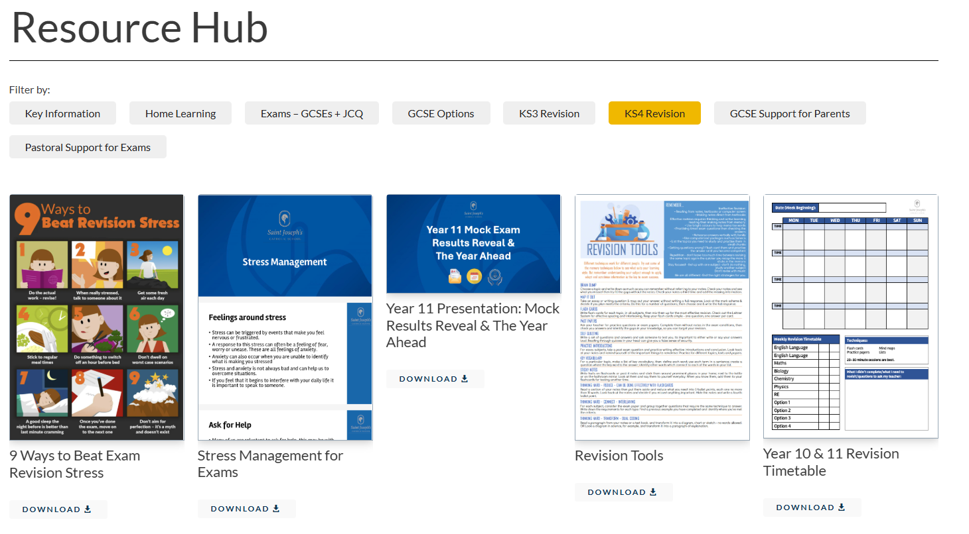
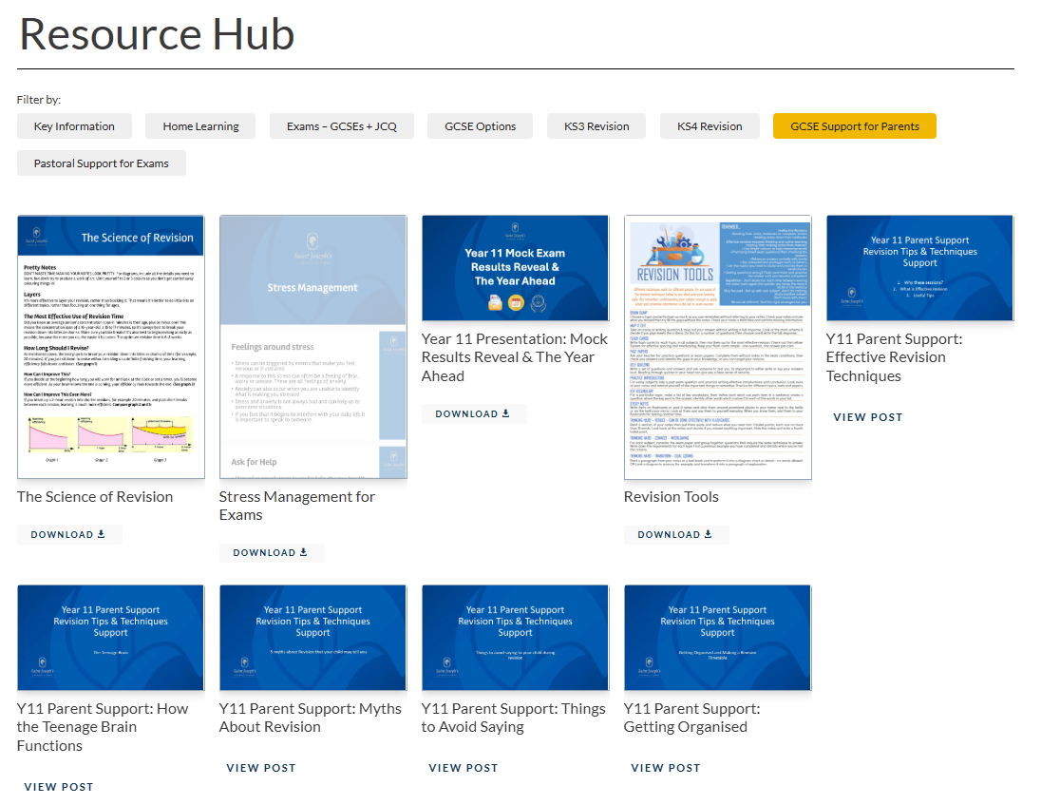
School Website – Resource Hub https://www.sjcs.org.uk/resources/
Pupils:
Parents:

Slide 11
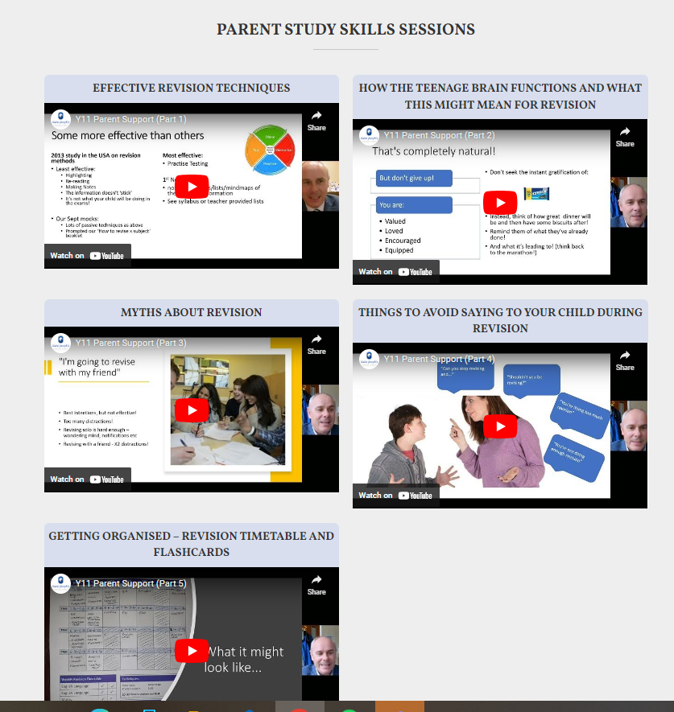
School Website School Website – Resource Hub https://www.sjcs.org.uk/resources/
Parent Videos on Study Skills & How to Help your child:
Effective Revision Techniques (15mins)
How the Teenage Brain works (10mins)
Myths about Revision (9 mins)
Things to avoid saying to your child (7 mins)
Getting organised – timetables & flashcards (12 mins)

Slide 12


Revision: Past Papers & MarkSchemes
Past Papers & Mark Schemes – exam board websites in pack
Other useful websites:
https://revisionworld.com/gcse-revision
https://www.savemyexams.com/
All subjects, past papers and markschemes in one place.
Also has revision resources too and video clips.
Most effective revision is active revision;
Self-testing
Past questions
Timed answers
Passive is not effective:
Reading
Highlighting

Slide 13
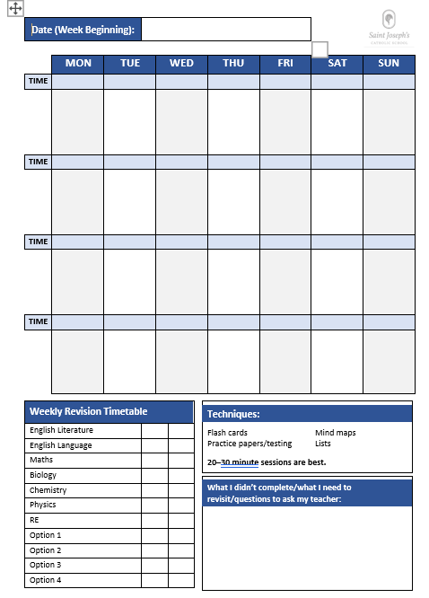
Getting Organised – Revision Timetable

Slide 14
Contingency Day
JCQ assign a day at the end of the examination period, which is Wednesday 24th June 2026, as a Contingency Day in case any examinations need to be rescheduled nationally for any reason affecting the whole country.
All candidates are instructed to ensure that they are available on this date in case any of their examinations have to be rescheduled.

Slide 15
Revision Programme & Flexi-Leave
During the exam window, we will be incorporating a structured revision programme.
A period in the morning will be set aside for revision guided by subject specialists for those exams in the afternoon
A period in the afternoon will be set aside for revision guided by subject specialists for those with exams the following morning
This will continue up to May half term when exams 'thin out'
We will then be operating a bespoke strucutred revision programme for the final 3 weeks of the exam period – this will be called flexi leave and pupils will attend school for their exams or revision session only.

Slide 16
Clashes – Multiple Exams
Tuesday 12th May:
AM: RE Component 1 (1hr 30)
AM: Design (1hr 15)
PM: Biology (1hr 15 / 1hr 45)
Design exam will happen straight after RE exam
Pupils impacted will remain in their exam location until morning exams have finished

Slide 17
Exam Results Day
Result day will be on Thursday 20th August, these will be available to pupils to collect from 10:00am to 11:00am.
Pupils who are unable to attend this date with prior arrangement can request these to be emailed, which will happen later in the afternoon.
We request that the pupils complete a form to advise us the email address their results are to be sent to. Any results not collected or emailed will be sent home by post.

Slide 18

Key Points
Your packs consist of:
2 exam timetables
An information booklet from school and also JQA
Use the resources that work for you!
Have a clear revision timetable
A good meal and some water will help with focus

Slide 19
Parents…
Check
Please check the night before that your child is ready for the exam the next day.
Check
Please check that they have eaten something in the morning.
Encourage
Please encourage them to leave home in good time for the exam.
Monitor
Please monitor screen time
Be
Please be sensitive to your child’s feelings if they have had a bad exam experience that day.

Slide 20

Any Questions?

