Slide 1


Exam Information Evening

Slide 2

Improved my grades
Put a 100% in and beyond
Lavy Final
Starting my revision
Revised
Passed English
Good maths mock
Did my mocks #passed
My revision and personally I feel like I am still trying my best come GCSE’s
Been a good friend
Im proud of always believing in myself and not giving up even in the toughest time I still keep going
Got an 8 in English
Got Empoyed
Hit 90kg Bench
Dance Off
Pushed myself to become the best version of myself
Done Dance Live
Got closer with god
Been revising
Passing maths
My personality beliefs and interests have changed and matured
I did good in my exams
Doing good Deeds​​
I feel proud for keeping going even when things get tough​​
Practicing for the dance off​​
Revised more​​
The amount of revision I did ​​
Applied for a job​​
Getting a good grade in English ​​
I am proud of trying my best in all of my lessons and avoiding distractions ​​
Big sleep​
Keep on going with my revision
School
I got a pass in maths
Being patient
Being myself
Trying hard to get science grade for a 3 – 9
Trying to make everyone around me smile
Getting through the term
Revising more
Playing in the last rugby game
Passed my mocks
Mock results
I showed up and tried
RE
I talk about my mental health to teachers when I got a problem to talk about it
Improved on my mock grades​
Carried on​
I stud lots – im proud​
Revising and dance off not stopping/giving up ​
Played the final – 2nd place! ​
Made people Happy​
Passing maths​
A good Friend​
Revised​
Getting better at maths​
Dance off​
Doing good things to others​
Showing up ​
Getting a good grade in maths​
Got a 6 in Science​
Know all the English kings & Queens from 1066-2925 ! ​
Helped a friend in a subject they struggled with​
Revising​
No days off​
Got accepted into my dream college​
Revised for my exams​
Won Hampshire Finals in Rugby​
Worked Hard​
Doing the big sleep ​
Was kind ​
I got to meet the best people of my life​

Slide 3


Welcome
We will cover the following:
Expectations
How to prepare the night before
How to prepare on the morning
How to deal with stress and support we can offer
Exam Timetables

Slide 4
Your Pack consists of:
Exam Timetable x 2
School Exam Information Booklet
JCQ Instructions for Candidates
School Information Booklet:
Rules & Regulations
Timings
AM exams – Reg at 8:45, Exams begin at 9:00
PM exams – Reg at 12:45, Exams at 1pm
Inform us of illness before 8am by calling school switchboard (medical evidence)
FAQ section - 'what if...'
JCQ Instructions:
Rules & Regulations

Slide 5

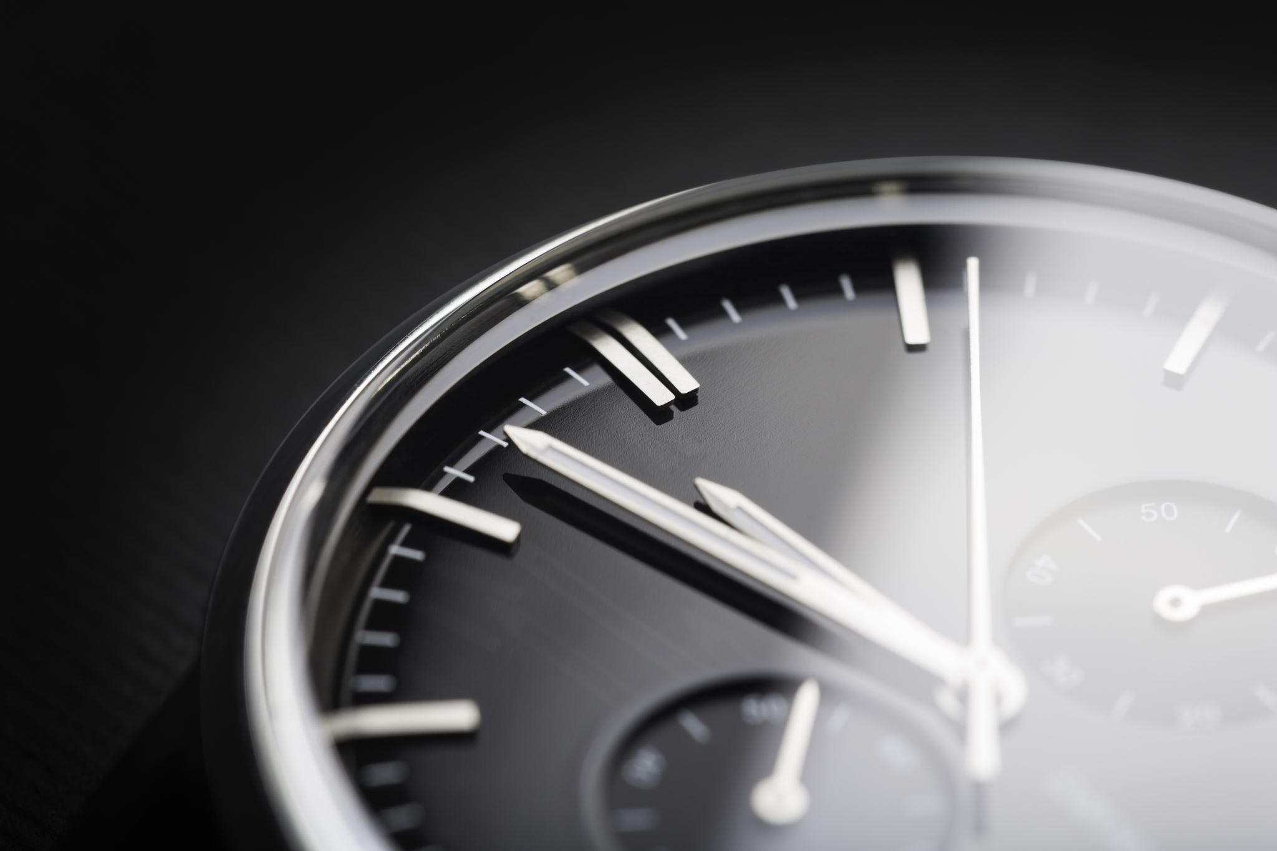
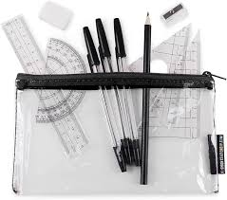
Expectations - Pupil
You arrive in full uniform
You arrive on time – 15 mins before the start of the exam
Do not bring in a watch.
You have all of your equipment including :
Black ball point pen and 2 spares
Ruler
Calculator

Slide 6
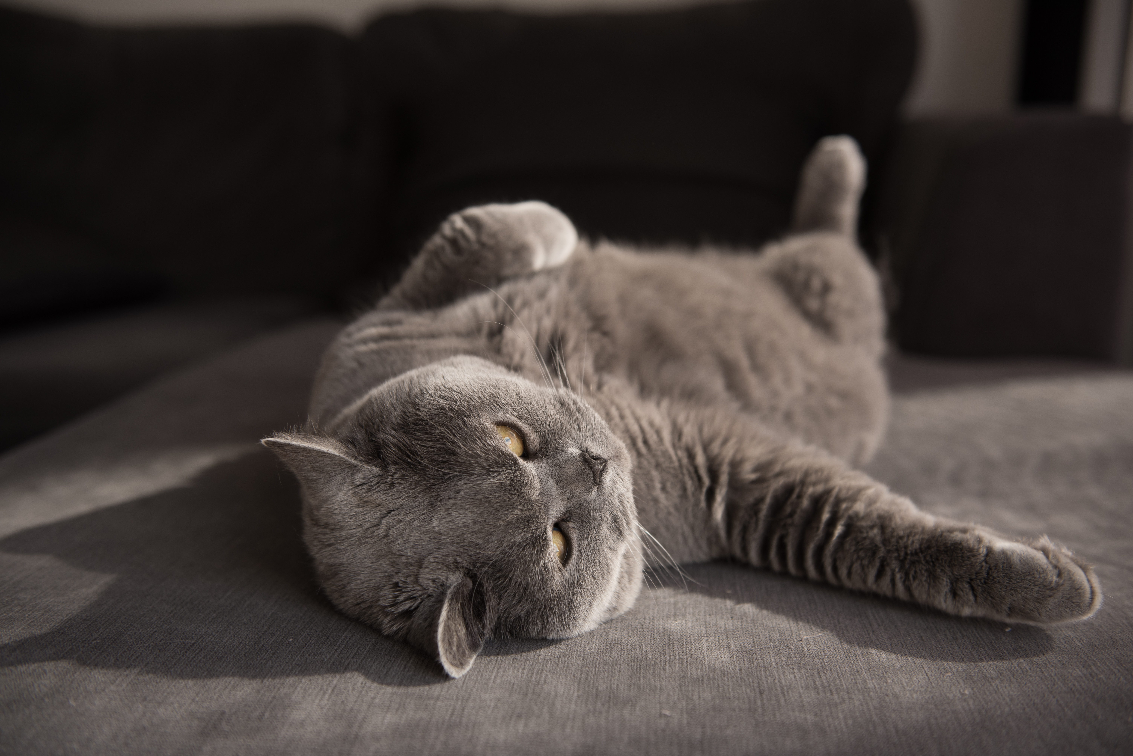
How to prepare the night before...
Stop revising at a reasonable time.
Have a good meal.
Switch off screens an hour before sleep.
Prepare uniform.
Pack equipment.
Headspace App. - Pupils can use the school email address to login.

Slide 7
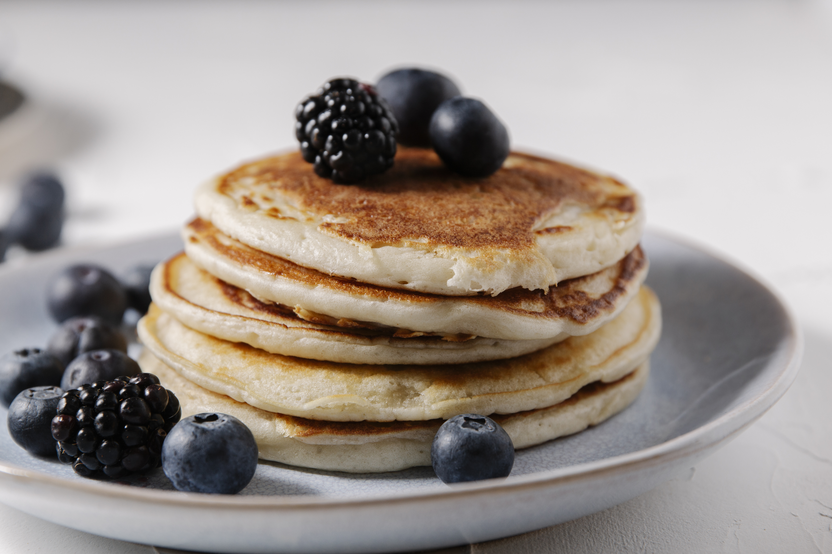
In the morning...
Get up in plenty of time. No rushing.
Have breakfast.
Double check bag and equipment.
Bottle of Water – No label
Leave to get to school in plenty of time.
Wear full school uniform.
Do not bring in valuables – Air pods, Apple watches,etc.

Slide 8
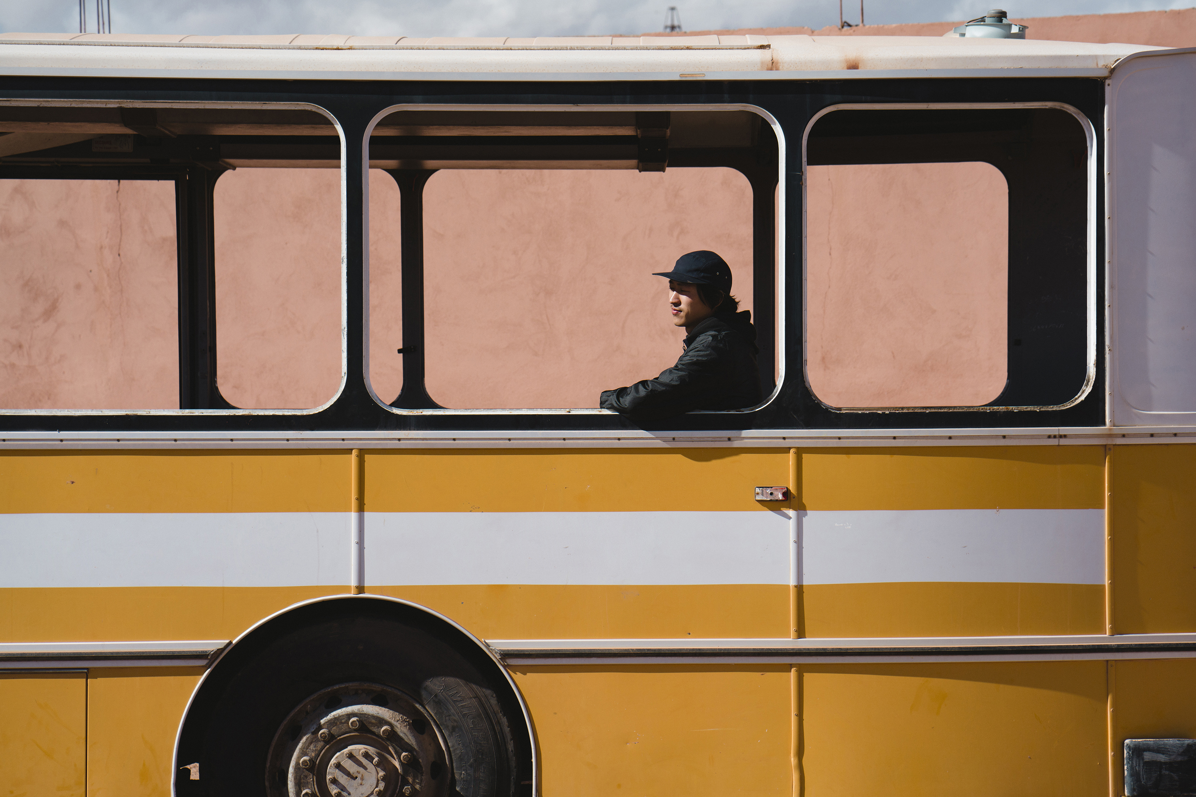
Arrival at school...
Canteen will be open from 8.30 to buy food
Pupils will be able to congregate in the canteen.
Staff will be there to discuss last minute worries and questions.
Bags will be left in the canteen side room.
Ensure phones are switched off, and left in bags and no electronic devices (including watches) taken into the hall.

Slide 9
How to deal with stress and how we can support you
In school:
Pastoral
Subject support from teachers
Mrs Kenney
Mrs Sheffield
Outside of school:
Headspace app
School website – lots of resources
Revision Guides
Look after yourself:
Go for a walk
Speak to friends & family
Carry on with your hobbies!

Slide 10
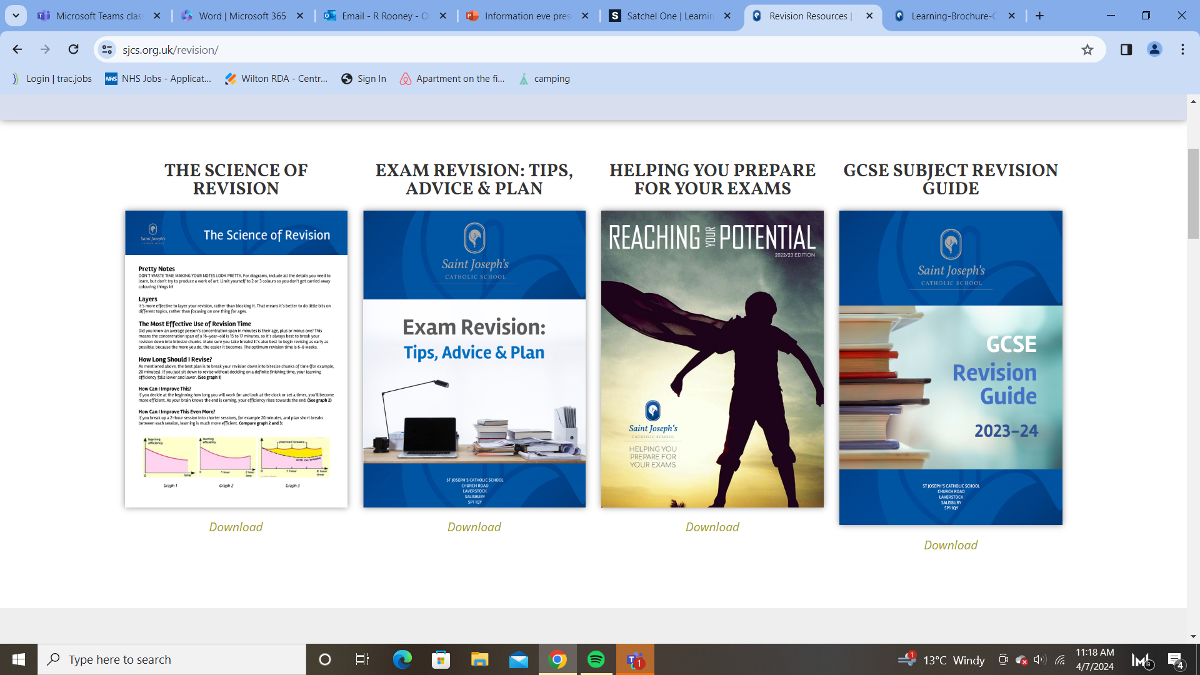
School Website https://sjcs.org.uk/revision/
Booklets:
Science of revision (2 pages)
Reaching your potential – useful guide on practical revision tips and techniques
GCSE Revision Guide – Subject Specific tips and techniques
  What you need to do
  Where to go for resources

Slide 11
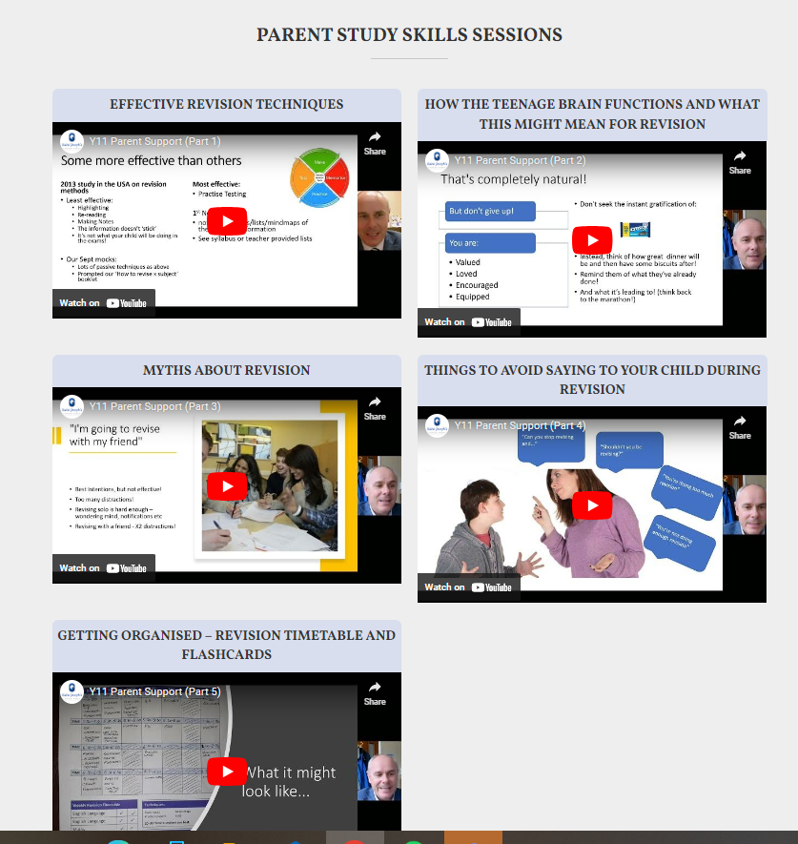
School Website https://sjcs.org.uk/revision/
Parent Videos on Study Skills & How to Help your child:
Effective Revision Techniques (15mins)
How the Teenage Brain works (10mins)
Myths about Revision (9 mins)
Things to avoid saying to your child (7 mins)
Getting organised – timetables & flashcards (12 mins)

Slide 12


Revision: Past Papers & MarkSchemes
Past Papers & Mark Schemes – exam board websites in pack
Other useful websites:
https://revisionworld.com/gcse-revision
https://www.savemyexams.com/
All subjects, past papers and markschemes in one place.
Also has revision resources too and video clips.
Most effective revision is active revision;
Self-testing
Past questions
Timed answers
Passive is not effective:
Reading
Highlighting

Slide 13
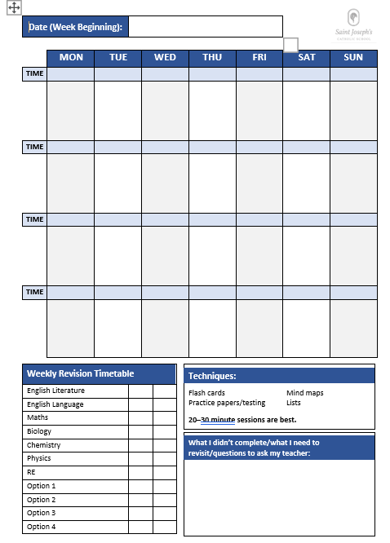
Getting Organised – Revision Timetable

Slide 14
Contingency Day
JCQ assign a day at the end of the examination period, which is Wednesday 25th June 2025, as a Contingency Day in case any examinations need to be rescheduled nationally for any reason affecting the whole country.
All candidates are instructed to ensure that they are available on this date in case any of their examinations have to be rescheduled.

Slide 15
Structured Revision Programme
During the exam window, we will be incorporating a structured revision programme.
A period in the morning will be set aside for revision guided by subject specialists for those exams in the afternoon
A period in the afternoon will be set aside for revision guided by subject specialists for those with exams the following morning
This will continue up to May half term when exams 'thin out'
We will then be operating a bespoke strucutred revision programme for the final 3 weeks of the exam period

Slide 16
Clashes – Multiple Exams
Tuesday 13th May:
AM: RE Component 1 (1hr 30)
AM: Design (1hr 15)
PM: Biology (1hr 15 / 1hr 45)
Design exam will happen straight after RE exam
Pupils impacted will remain in their exam location until morning exams have finished
Tuesday 20th May:
English Lit Paper 2 (2hr 15)
Computer Science Paper 2 (2hr)
Sociology Component 2 (1hr 45)
Impacts 5 pupils and we will speak to these individually
It will be a long day!

Slide 17
Exam Results Day
Result day will be on Thursday 21st August, these will be available to pupils to collect from 10:00am to 11.
Pupils who are unable to attend this date with prior arrangement can request these to be emailed, which will happen later in the afternoon.
We request that the pupils complete a form to advise us the email address their results are to be sent to. Any results not collected or emailed will be sent home by post.

Slide 18

Key Points
Your packs consist of:
2 exam timetables
An information booklet from school and also JQA
Use the resources that work for you!
Have a clear revision timetable
A good meal and some water will help with focus

Slide 19
Parents…
Check
Please check the night before that your child is ready for the exam the next day.
Check
Please check that they have eaten something in the morning.
Encourage
Please encourage them to leave home in good time for the exam.
Monitor
Please monitor screen time
Be
Please be sensitive to your child’s feelings if they have had a bad exam experience that day.

Slide 20

Any Questions?

